Slide 1
5. Probability
Probability is the study of ‘ ’
A random experiment is an experiment conducted any number of times, the result or the out come of which is
‘ ’.
Ex:- Tossing of a coin
The occurrence of Head or Tail is called an event

Slide 2
Probability
Types of events
1. Equally likely events
When all the events having equal chances of occurring
There is no reason why a particular event occurs more number of times

Slide 3
Probability
2. Mutually exclusive events
when the occur of one event, prevents the occurrence of another event
ex:- Head prevents Tail

Slide 4
Probability
3. Independent events
when the occurrence of one event, does not prevent the occurrence of another event
ex:- Pulling of Queen of Hearts from a deck of cards

Slide 5
Probability
Q – a letter card
Heart -> Design
Colour – Red
All the three events occur together and one does not prevent the other

Slide 6
Probability
Addition Theorem of Probability
If A and B are two events then P( A U B) = P(A) + P(B) - P(A n B)
If events A and B are mutually exclusive then P( A nB) = 0
∴ P (A U B) = P ( A) + P ( B)
If A and B are independent then P (A n B) = P ( A) x P ( B)

Slide 7
exercise
If P(A) = 0.5 and P(B) = 0.4 find P( A U B)
If events A and B are a) mutually excusive b) independent

Slide 8

Probability
Definition of Probability
If the ‘p’ of the event ‘E’ occurring is denoted by P(E) then the ‘P’ of the event ‘E’ not occurring is denoted by $P\left(\overline{E}\right)$ then P(E) + $P\left(\overline{E}\right)=1$
P(E) = 1 - $P\left(\overline{E}\right)$

Slide 9
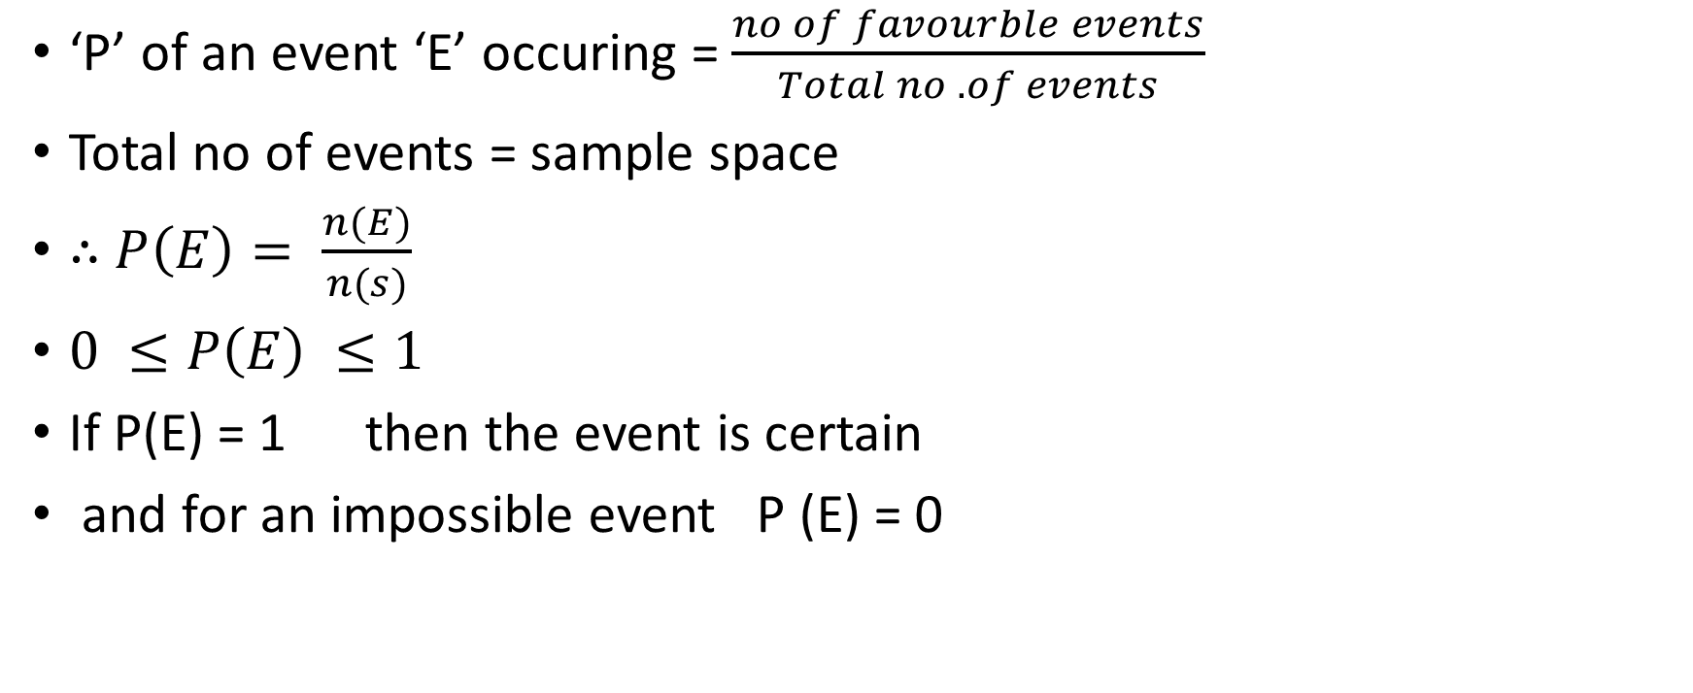
Probability
‘P’ of an event ‘E’ occuring = $\frac{no of favourble events}{Total no .of events}$
Total no of events = sample space
∴ $P\left(E\right)= \frac{n(E)}{n(s)}$
$0 ≤P\left(E\right) ≤1$
If P(E) = 1 then the event is certain
and for an impossible event P (E) = 0

Slide 10

Probability
Odds in favour ratio:
P(E) : P$\left(\overline{E}\right)$
Odds against ratio
$P\left(\overline{E}\right) :P(E)$
$if P\left(E\right)=\frac{5}{12}=\frac{5}{5+7}$
then odds in favour ratio = 5 : 7
and odds against ratio = 7: 5

Slide 11
Probability
A coin is tossed 3 times Find the odds against ratio for getting a Head at least once

Slide 12
exercise
A coin is tossed 5 times .what is the probability for head occurring
3 times or 5 times.

Slide 13
Exercise
A coin is tossed 10 times. Find the probability for the head appearing at least 7 times.

Slide 14

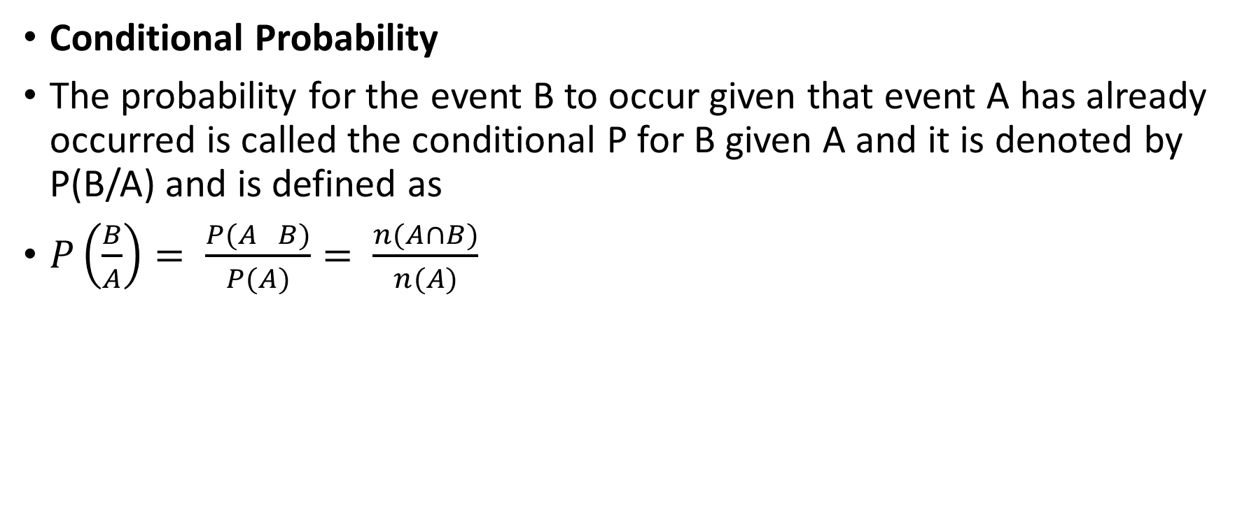
Probability
Conditional Probability
The probability for the event B to occur given that event A has already occurred is called the conditional P for B given A and it is denoted by P(B/A) and is defined as
$P\left(\frac{B}{A}\right)= \frac{P(A B)}{P(A)}= \frac{n(A∩B)}{n(A)}$
$$∩$$

Slide 15
Conditional Probability
Two dice are thrown simultaneously once and the sum of numbers appearing on top is observed. Find the P for one of the dice to be a 2 given their sum is 6.

Slide 18
Probability
. A bag contains 4 green, 6 black and 7 white balls. A ball is drawn at random. What is the probability that it is either a green or a black ball?

Slide 19
Probability
Three bags A,B,C contain balls as given below. Bag A:2 white, 2 red, 1 Black, Bag B:3 White , 4 red, 2 Black, Bag C: 4 white, 2 red, 3 black. A die is thrown. If either 1 or 2 2 turns up bag A is chosen; if either 3 or 4 turns up bag B is chosen and if either 5 or 6 turns up bag C is chosen. Of the bags, a bag is selected and from it a ball is chosen at random. If the ball is red, find the probability that it is from bag B?

Slide 20
Probability
Out of a box that contains 4 black and 6 white mice, three are randomly chosen. What is the probability that all three will be black?

Slide 21

Probability
. The probability of Sam passing the exam is $\frac{1}{4}$. The probability of Sam passing the exam and Michael passing the driving test is $\frac{1}{6}$. What is the probability of Michael passing his driving test?

Slide 22

Probability
. In jar there are balls in different colors: blue, red, green and yellow. The probability of drawing a blue ball is $\frac{1}{8}$. The probability of drawing a red ball is $\frac{1}{5}.$ The probability of drawing a green ball is $\frac{1}{10}$. If a jar cannot contain more than 50 balls, how many yellow balls are in the jar?
.

Slide 23
Probability
In a jar there are 3 red balls and 2 blue balls. What is the probability of drawing at least one red ball when drawing two consecutive balls randomly?

Slide 24
Probability
. What is the probability of getting a sum of 12 when rolling 3 dice simultaneously? .

Slide 25
Probability
A six sided dice with faces numbered 1 thru 6 is rolled twice. What is the probability that the face with number 2 on it would not be facing upward on either roll?

Slide 26
exercise
A die is rolled once. What is the probability for:
1) getting any number 2) getting an odd number 3 ) an even number
4) a prime number 5) an odd prime number 6) an even prime number

Slide 27
exercise
Two dice are thrown simultaneously once. Find the probability for the sum of numbers appearing on to be a perfect square.

Slide 29
Probability
What is the probability that a card drawn at random from the pack of playing cards may be either a queen or a king?

